Slide 1
Chapter 9 The Role of Events for Winter Sport Tourism
Simon Hudson

Slide 2
Topic Covered
The growth of events
Types of events
Planning and operating events
Marketing events
Leveraging events

Slide 3
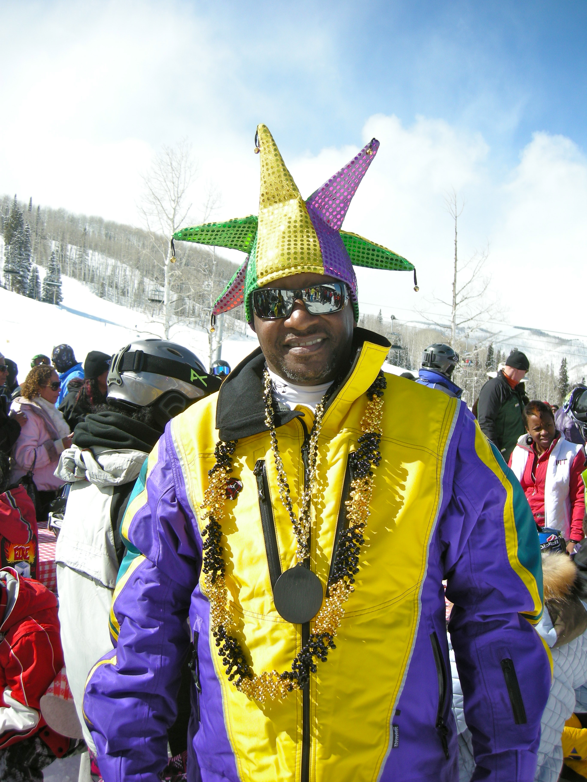
Spotlight Skiing African-American style
Lenore Benoit, membership director
African Americans: a minority in winter sports
Special events for tag-along non-skiers

Slide 4
The growth of events
Role of events
Important to tourist, social and cultural functions
local and regional development
Three industries shape the growth of the events sector
hospitality industry (hotels, restaurants or venues)
tourism industry stakeholders (DMOs, local authorities or trade associations )
marketing and public relations practitioners

Slide 5
Three industries shaping the growth of events
Policy and Planning
Destination Branding
Travel Intermediaries
Transportation
Events
Tourism
Public Relations
Hospitality
Entertainment
Product Launches
Purpose-built Venues
Corporate Reputation
Food and Beverage
Sponsorship
Accommodation
Internal Communications
Source: Adapted from Jackson, 2013, p. 7

Slide 6
Types of Events
Elite and non-elite competitor events
Festivals
Conventions and exhibitions
International meetings
Virtual events

Slide 7
Sports included in the Winter Olympic Games for 2018
Ice sports | Alpine, skiing and snowboarding events | Nordic events
Bobsled (Two-man, Two-women & Four-man) Luge Skeleton Figure skating (Men’s and Women’s singles, Pairs, Team and Ice Dancing) Speed skating Short track speed skating (500m, 1,000m, 1,500m and Relays) Curling | Alpine skiing (Downhill, Super G, Giant Slalom, Slalom, Super Combined) Freestyle skiing (Aerials, Moguls, Ski Cross, Ski Halfpipe, Ski Slopestyle) Snowboarding (Parallel Giant Slalom, Halfpipe and Snowboard Cross and Slopestyle) | Biathlon (combining cross-country skiing and target shooting: individual, sprint, pursuit, mass start and relay events) Cross-country skiing (individual and team sprint, freestyle, pursuit, classical and relays) Ski jumping Nordic combined (ski jumping and cross country skiing)

Slide 8
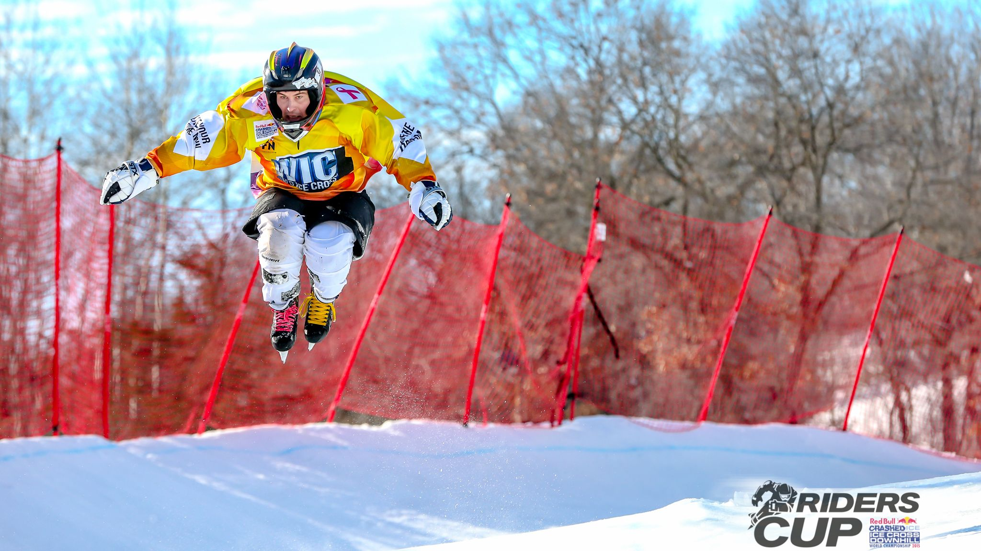
Profile: Crashed Ice
How to make the fledgling winter sport official
Four Crashed Ice events are held
U.S.A. (St Paul), Finland (Helsinki), Ireland (Belfast) and Canada (Edmonton)

Slide 9
Planning and operating events
Human resource management (five stages)
Corporate hospitality

Slide 10
Unique Operational Issues and Challenges for Events
Unique Operational Issues and Challenges for Events
Complex and risky event settings and programmes
Crowd emotions and behaviour
Lack of experience for one-time events
Peak demand periods and simultaneous entry or exit from venues
The perishability of event capacity
The need to be ‘green’
based on Getz, 2007, p. 275

Slide 11
Management practices for event organizers
Source: Hanlon & Stewart, 2006, p. 83

Slide 12
Marketing events
The components of event marketing practice
Securing a title sponsor
Gain media coverage for the event
Evaluate the success of the event

Slide 13
The components of event marketing practice
Marketing activity | Core event marketing purpose
Market research | Evaluate whether or not to put on an event Identify potential markets Evaluate communication methods used to attract participants and spectators Evaluate the success of the event
Marketing management | Create a marketing strategy Position an event relative to competition Construct and implement a marketing plan
Supply chain management | Identify how visitors with ‘consume’ the event via distribution/ticketing Manage venue, suppliers (technical and participants) and equipment Manage e-commerce
Brand management | Identify the corporate message an event wishes to portray Develop a mission statement, event logo and corporate image Dovetail sponsors’ objectives within overall brand image
Marketing communication | Provide external communication to potential consumers Manage media coverage Generate sales leads Utilize digital marketing
Internal marketing | Communicate with staff and volunteers
Consumer relations | Construct mechanisms to understand consumer needs Develop standards and systems for meeting those needs Manage corporate hospitality and VIPs
Market and marketing evaluation | Construct evaluative measures Assess whether or not the event has met its objectives Learn, and suggest lessons for improvement
Source: Adapted from Jackson, 2013, p. 41

Slide 14
Leveraging events
Economic leveraging
strengthen a destination’s brand
cope with seasonality and to boost tourism receipts
Social leveraging
the facilities created for the occasion but later used by locals
Environmental leveraging

Slide 15
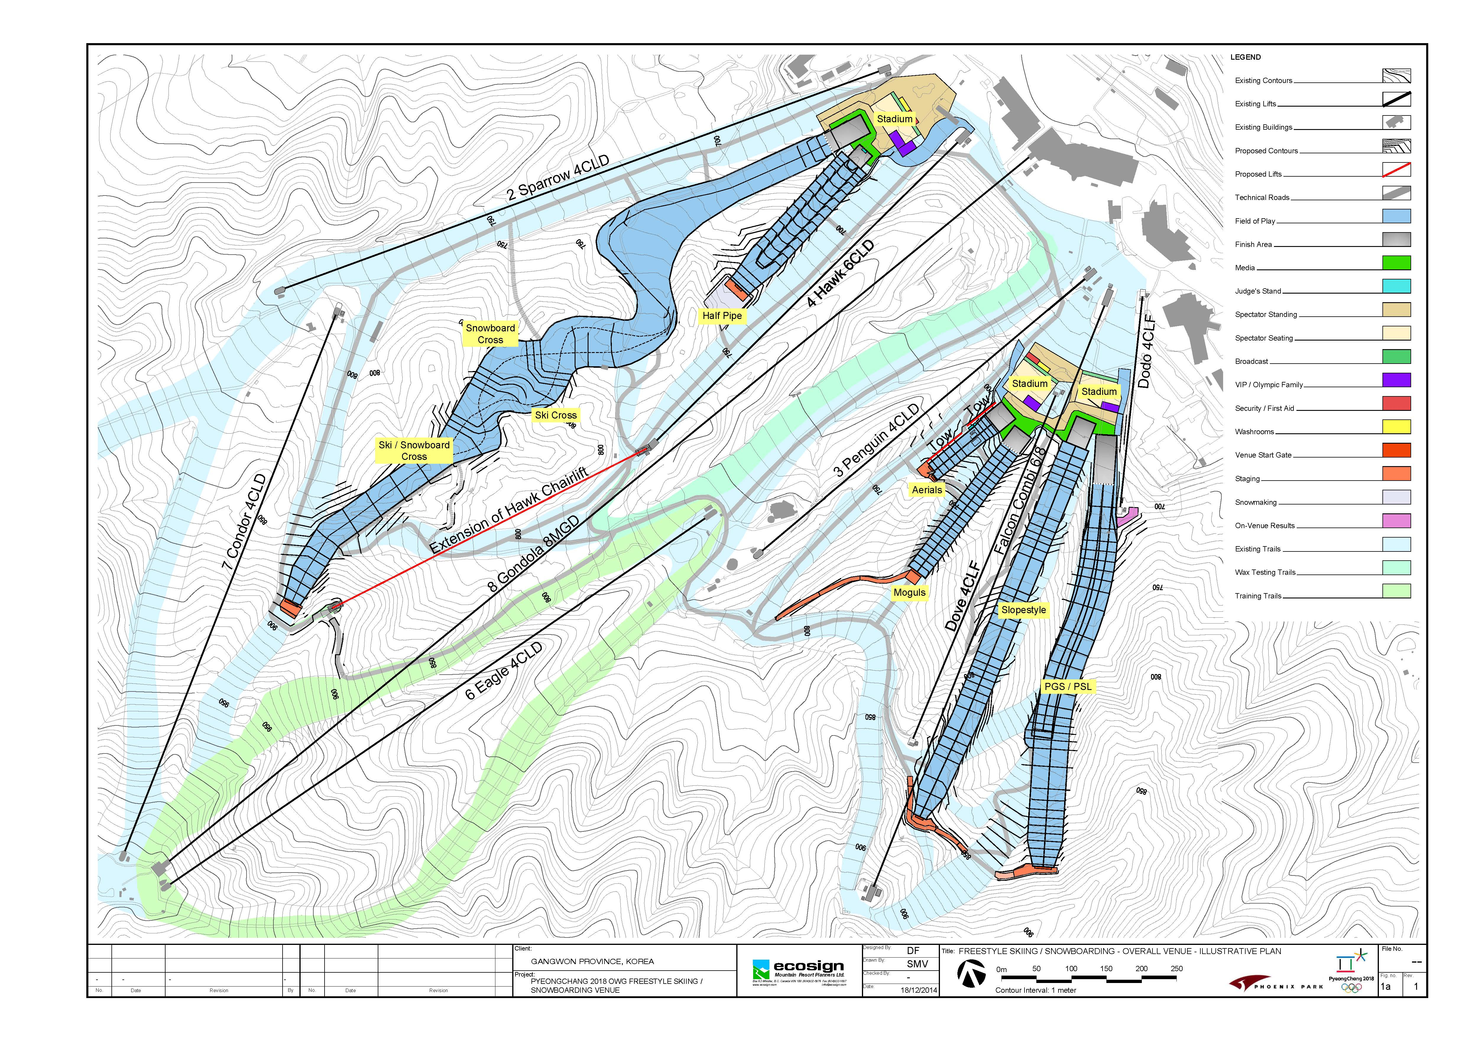
Case study: Planning the South Korea 2018 Winter Olympics
Public sentiment surrounding big sporting events is no longer unanimously positive
The process of creating any Olympic venue is typically fraught with unexpected problems.

